Slide 1
Fundraising Campaign
Pittsburgh Urban Farmers
HILL DISTRICT FOOD ACCESS WORKING GROUP
HOMEWOOD FOOD ACCESS WORKING GROUP FARM TO TABLE BUY LOCAL

Slide 2
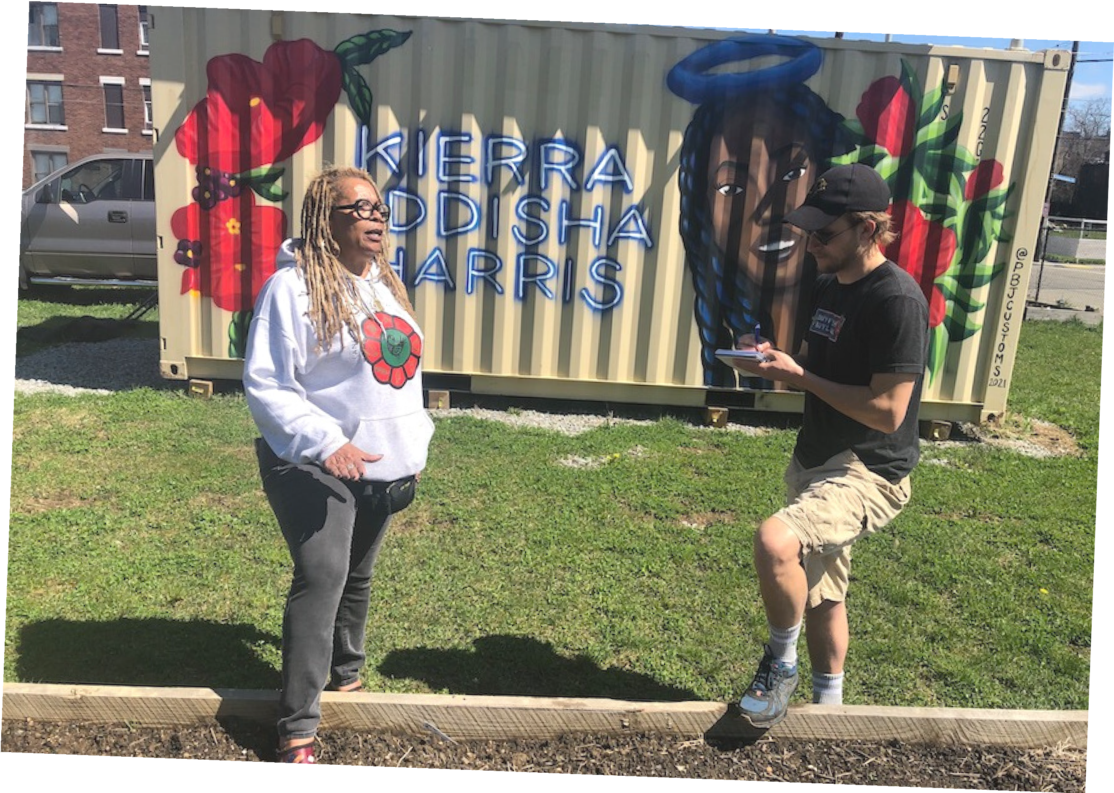
Introduction
Pittsburgh is home to amazing individuals who started urban farms and community gardens in Black communities that are suffering from decades of food apartheid.
These community leaders work in the Hill District, Homewood, Manchester, Beltzhoover, the West End, and more neighborhoods in the region.

Slide 3
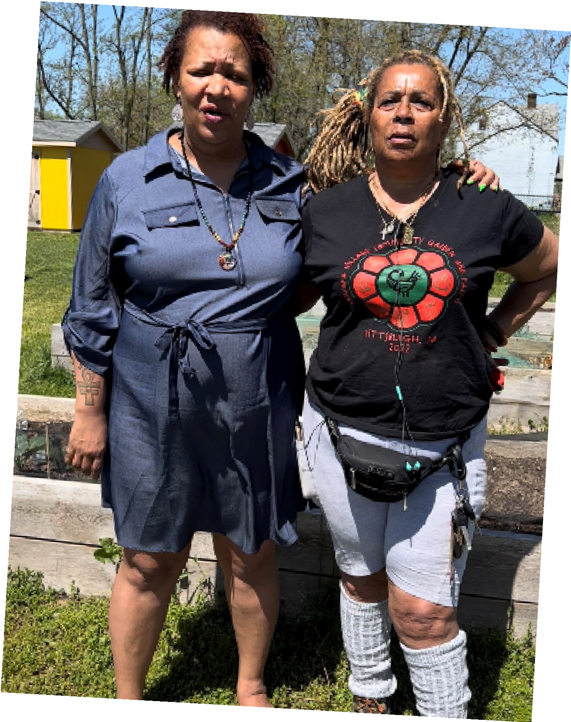
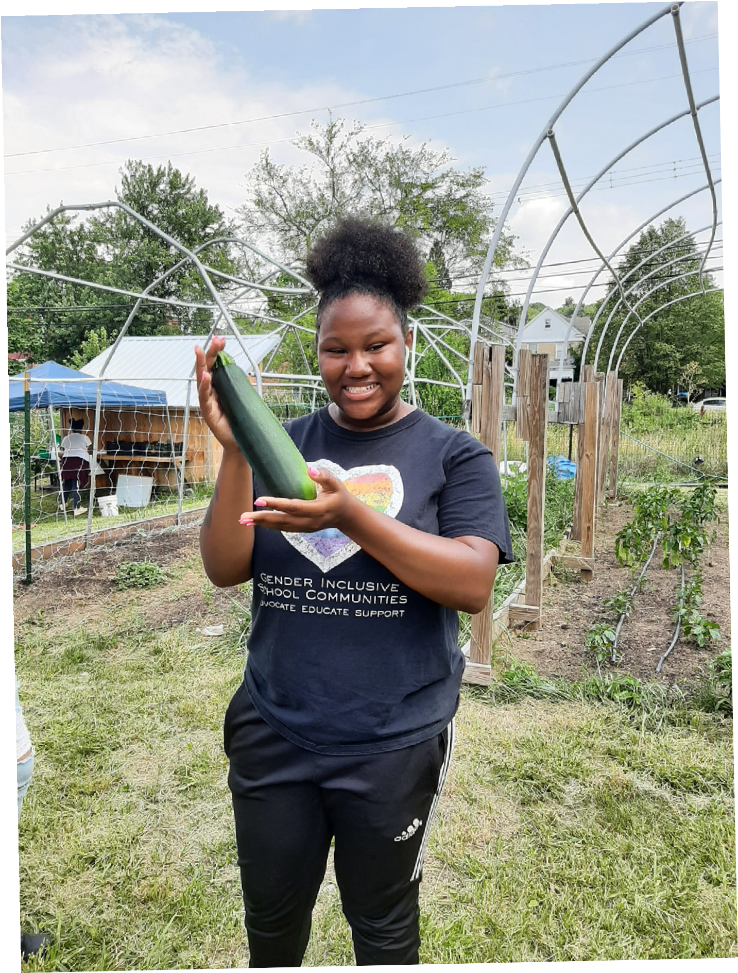
Black-led Organizations Delivering Fresh Food
Black Urban Gardners of Pittsburgh Food Co-op Feed the Hood
MLK Community Garden Oasis Farm + Fishery
Operation Better Block's Jr. Green Corp Out of the End Incorporated
Peace + Friendship Farm
Sankofa Village Community Farm + Garden

Slide 4
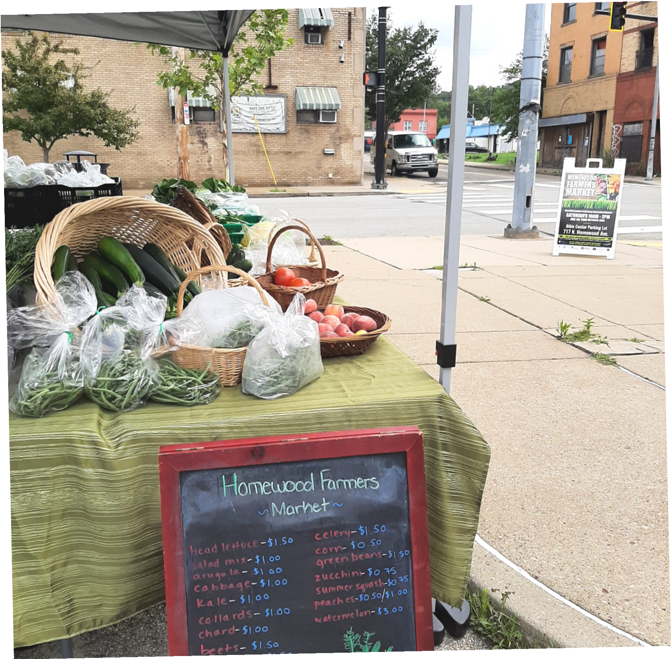
Success Over Time
PROGRAMS
Urban Farms have distributed food before the pandemic, during the pandemic, and will continue to do so in the future. Families and seniors in Homewood and the Hill District were able to rely on the efforts of these urban farms and gardens to grow and/or produce fresh, healthy food. These items were delivered door-to-door- to ensure access for everyone.

Slide 5
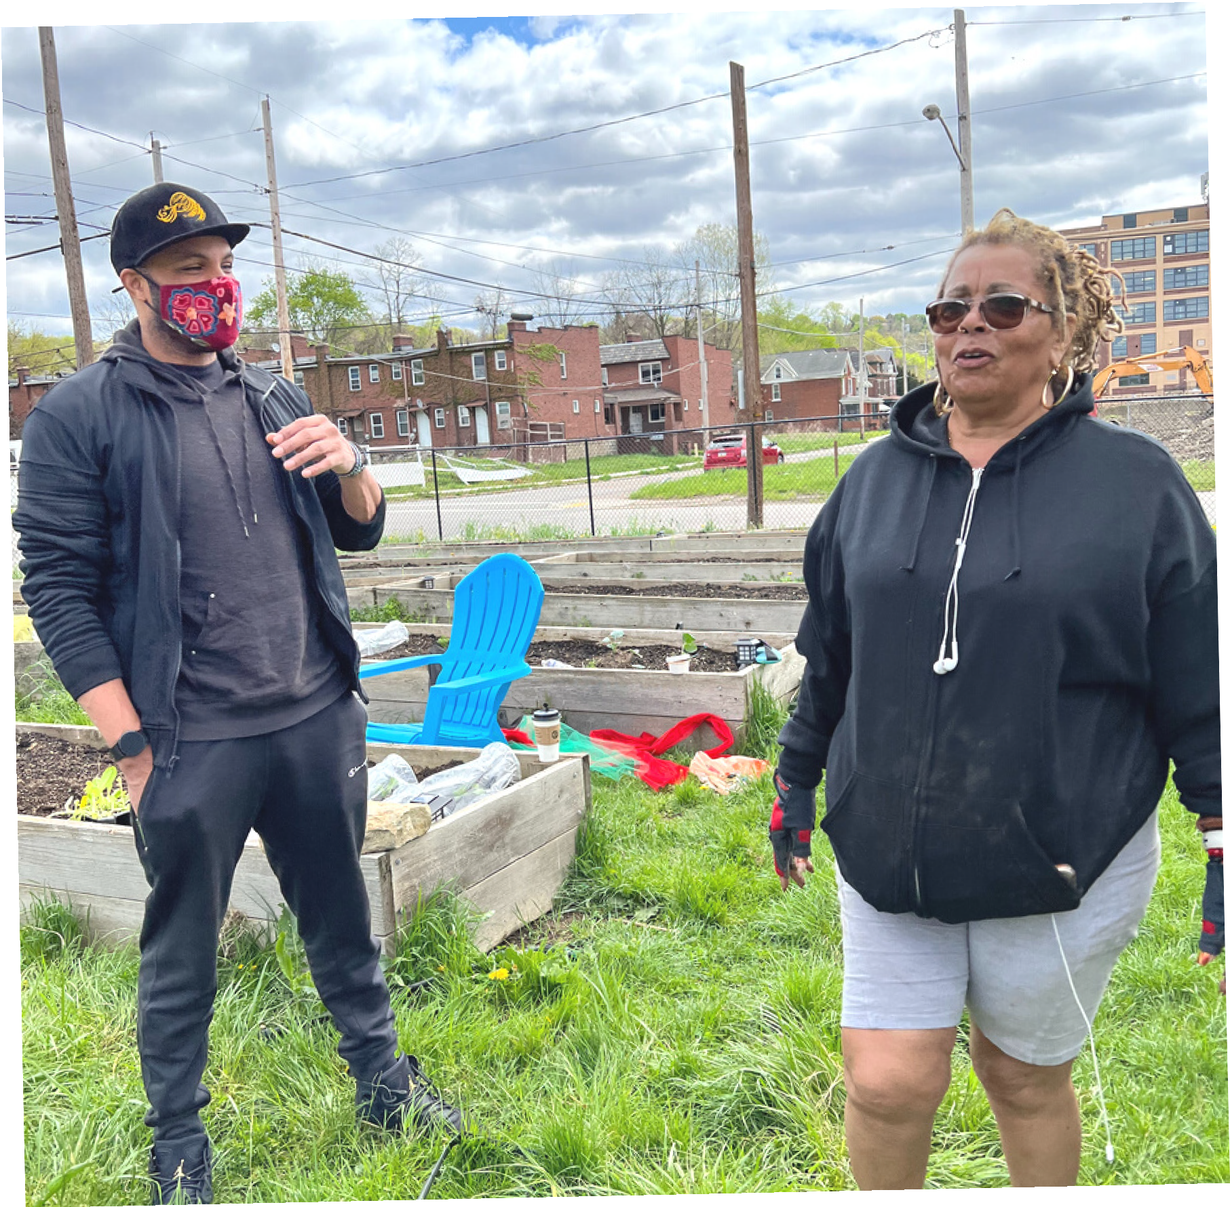
Success Over Time
FUNDING
The Homewood Food Access Working Group has successfully obtained $80,000 in funding from PA Department of Agriculture Urban Farm Infrastructure grants. The Hill District Food Access Working Group and Homewood Food Access Working Group have secured funding from The Heinz Endowments for infrastructure needs.

Slide 6
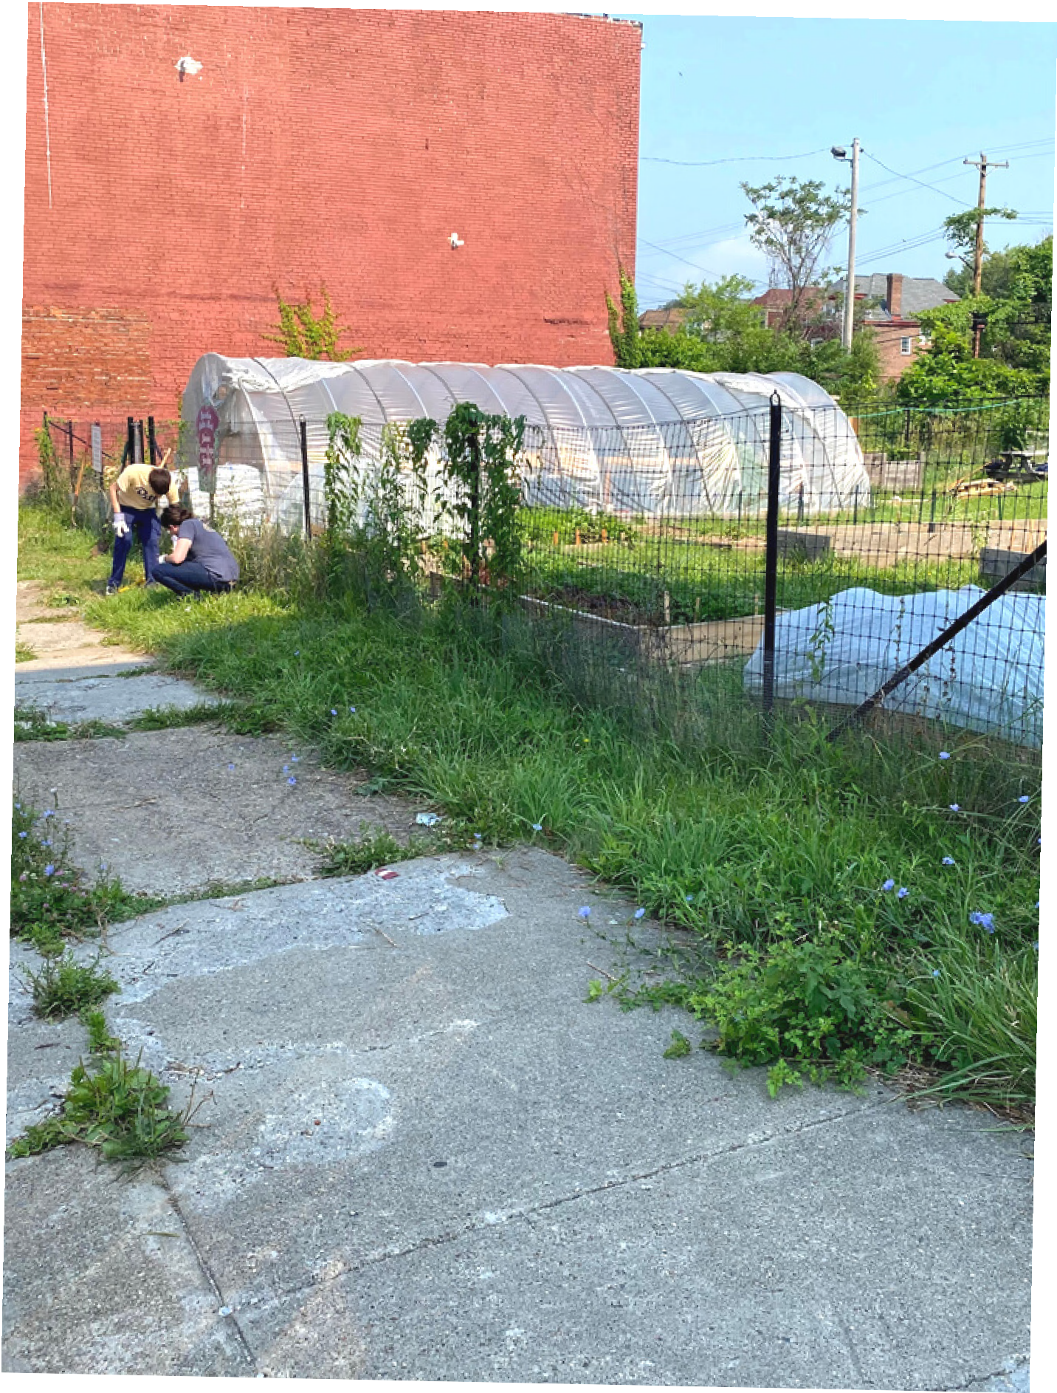
Levels of Support for Urban Farms
Fundraising dollars support urban farm infrastructure projects such as solar power, irrigation, shade structures, washing stations, seeds, compost, and so much more!
Additionally, many staff members are working for free on land they don't own. More needs include: acquiring land, compensating staff, purchasing equipment through co-operatives and capturing more food dollars that are spent by people living in the neighborhoods by working with WIC, SNAP, and PASS programs

Slide 7
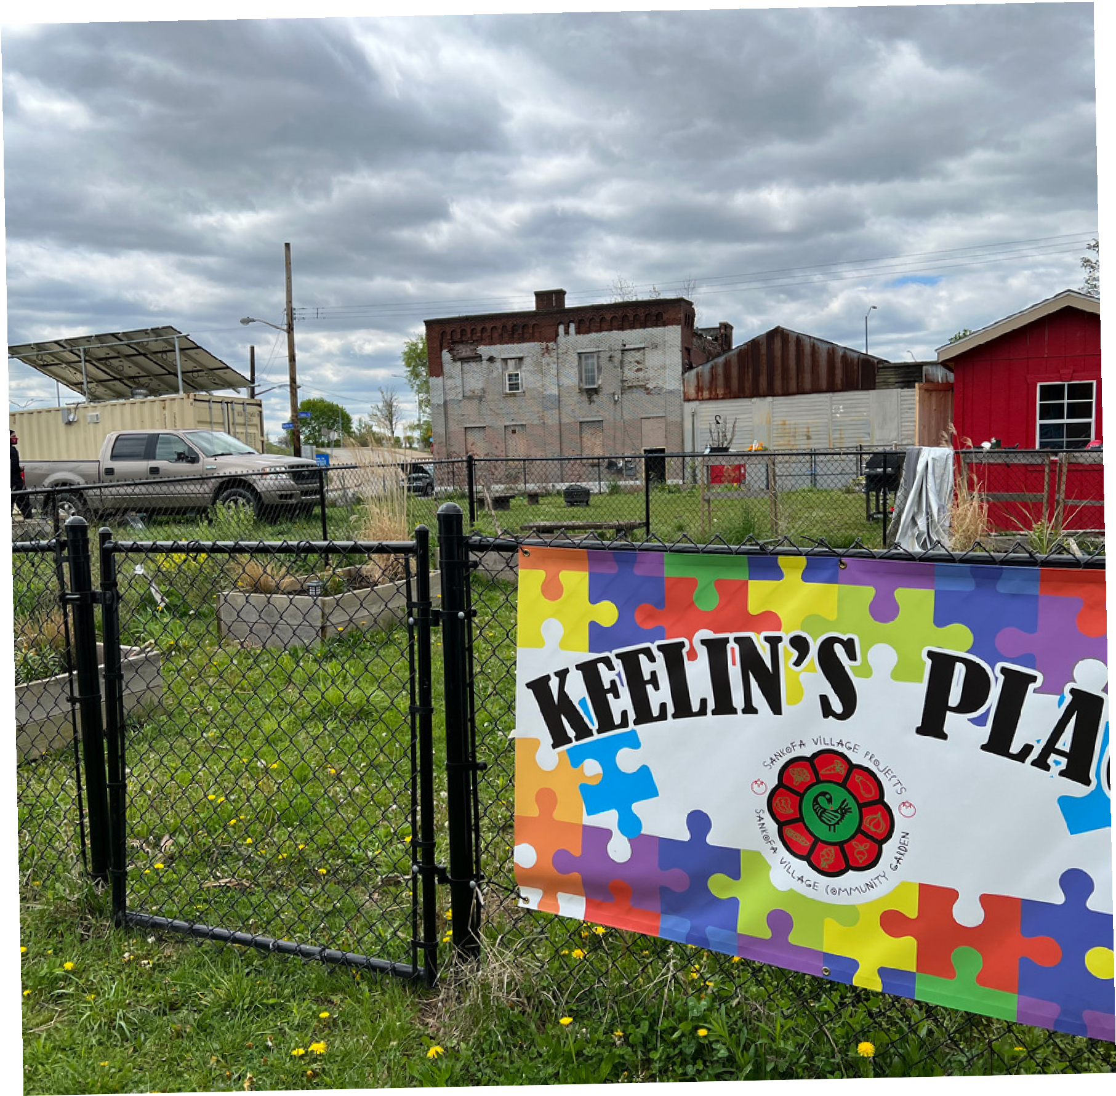
Levels of Support for Urban Farms
The funding also supports the intergenerational STEAM program - Science, Technology, Environment, Agriculture, and Math.
Friends of Urban Farms ($5,000-$10,000) Sustaining Sponsorships ($25,000-$50,000) Field of Dreams ($100,000-500,000)

Slide 8
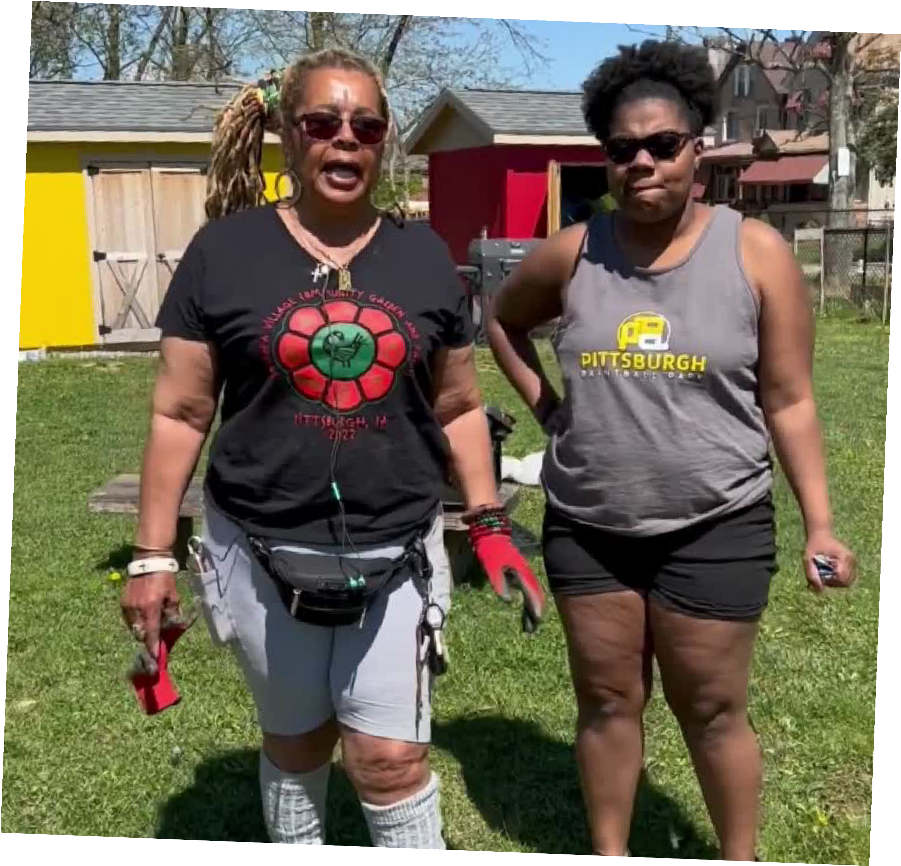
Queeba Bey from BUGS-FPC + Ayanna Jones made a video about their work.
https://www.youtube.com/watch? v=XT66D1G74vw

Slide 9
Upcoming Partnership Opportunities
FARM TO TABLE X BARREL & FLOW PRESENT:
An Urban Farmers Brew Market & Fundraiser at Sankofa Village Community Farm & Garden, Susquehanna St and N Brushton Ave, Pittsburgh, PA 15208
July 9, 2022 | 12-4 pm
Farm to Table Public Relations campaign will acknowledge support in press releases and monthly advertising campaigns in Table Magazine, Pittsburgh Magazine, and other ongoing ads in City Paper and WQED

Slide 10
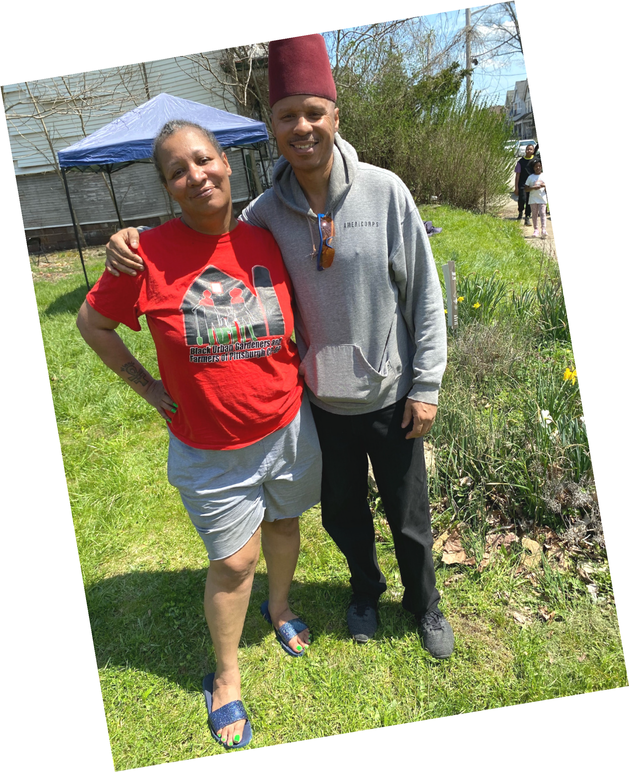
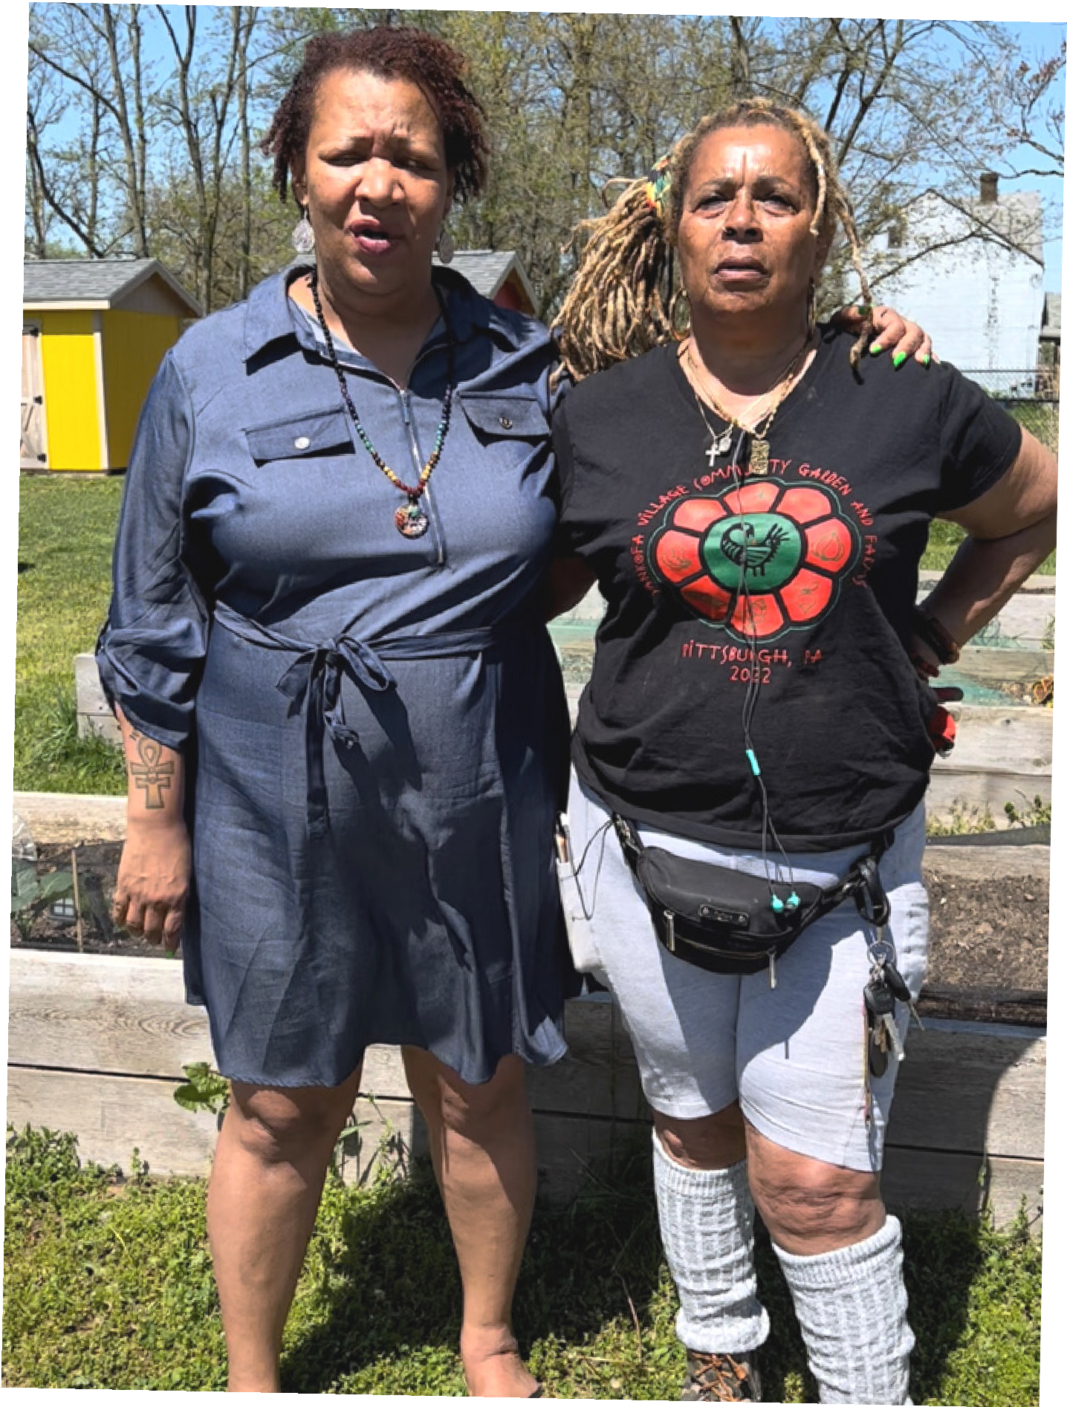
Stay In Touch With Us
EMAIL
Erin Hart erin@farmtotablepa.com Executive Director
MOBILE
412-657-3028

Slide 11
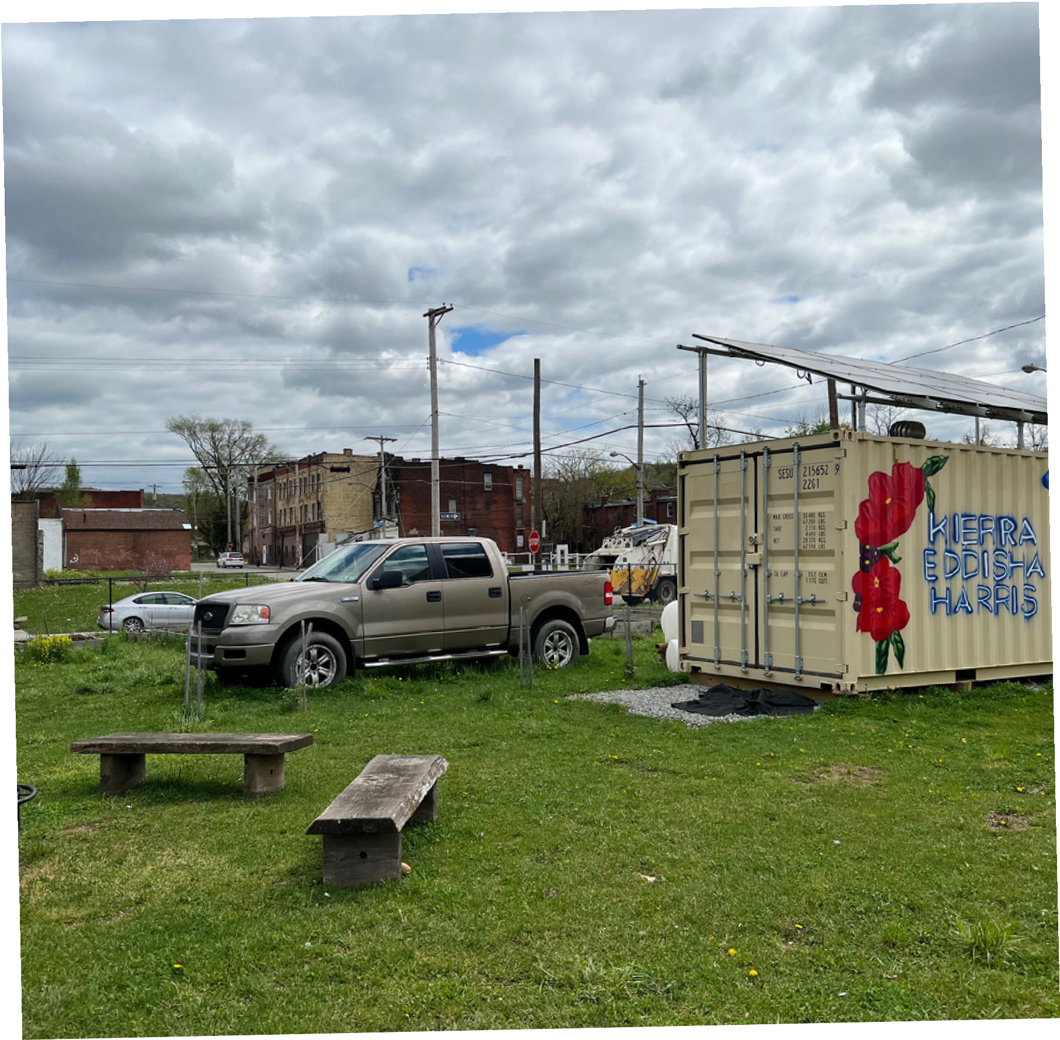
Fundraising Campaign
Thank You
HILL DISTRICT FOOD ACCESS WORKING GROUP HOMEWOOD FOOD ACCESS WORKING GROUP FARM TO TABLE BUY LOCAL

