Slide 1
USDA Good Agricultural Practices Overview
Danielle Dwan
February 2023

Slide 2
What are GAPs?
Good Agricultural Practices, or GAPs, are voluntary guidelines for produce farmers to reduce the risk of microbial contamination related to food borne illnesses on their farms.
The guidelines are based on the Food and Drug Administration (FDA)’s Guide to Minimizing Microbial Food Safety Hazards for Fresh Produce.

Slide 3
Why GAPs?
48 million people in the U.S. (1 in 6)
get sick, 128,000 are hospitalized, and
3,000 die each year from foodborne
diseases, according to recent data from
the Center for Disease Control.

Slide 4
The Consequence of Foodborne Illness
You may have read in the news about food contaminated with Salmonella, E. coli O157:H7, Listeria, or Hepatitis A.
These and other pathogenic microbes cause over 75 million people to get sick each year.
Most cases are not very serious, but the very young, the elderly, and people with impaired immune systems can become seriously ill and sometimes even die.
There is no way to know for sure how much foodborne illness originates on the farm, but the number of illnesses traced to fresh produce has grown faster than any other type of food.

Slide 5
Why GAPS?
2011 Multistate Outbreak of Listeriosis Linked to Whole Cantaloupes from Jensen Farms, Colorado (FINAL UPDATE)
Recent foodborne disease outbreaks traced to fresh produce have caused consumers to question the safety of our fresh food supply.

Slide 6
Food Safety Modernization Act
This is a significant public health burden that is largely preventable.
The FDA Food Safety Modernization Act (FSMA) is transforming the nation’s food safety system by shifting the focus from responding to foodborne illness to preventing it.

Slide 7
Food Safety Modernization Act
Signed into law in 2011
The safety of the food supply is a shared responsibility among many different points in the global supply chain for both human and animal food.
The FSMA rules are designed to make clear specific actions that must be taken at each of these points to prevent contamination.

Slide 8
Rules and Regulations of FSMA
Agricultural Water
Accredited Third-Party Certification
Food Traceability
Foreign Supplier Verification Programs (FSVP)
Laboratory Accreditation for Analyses of Foods (LAAF)
Mitigation Strategies to Protect Food Against Intentional Adulteration
Preventive Controls for Human Food
Preventive Controls for Animal Food
Produce Safety
Sanitary Transportation of Human and Animal Food
Voluntary Qualified Importer Program (VQIP)

Slide 9
FDA Guidance for Industry: Guide to Minimize Microbial Food Safety Hazards for Fresh Fruits and Vegetables
Principle 1. Prevention of microbial contamination of fresh produce is favored over reliance on corrective actions once contamination has occurred.

Slide 10
FDA Guidance for Industry: Guide to Minimize Microbial Food Safety Hazards for Fresh Fruits and Vegetables
Principle 2. To minimize microbial food safety hazards in fresh produce, growers, packers, or shippers should use good agricultural and management practices in those areas over which they have control.

Slide 11
FDA Guidance for Industry: Guide to Minimize Microbial Food Safety Hazards for Fresh Fruits and Vegetables
Principle 3. Fresh produce can become microbiologically contaminated at any point along the farm-to-table food chain. The major source of microbial contamination with fresh produce is associated with human or animal feces.

Slide 12
FDA Guidance for Industry: Guide to Minimize Microbial Food Safety Hazards for Fresh Fruits and Vegetables
Principle 4. Whenever water comes in contact with produce, its source and quality dictates the potential for contamination. Minimize the potential of microbial contamination from water used with fresh fruits and vegetables.

Slide 13
FDA Guidance for Industry: Guide to Minimize Microbial Food Safety Hazards for Fresh Fruits and Vegetables
Principle 5. Practices using animal manure or municipal biosolid wastes should be managed closely to minimize the potential for microbial contamination of fresh produce.

Slide 14
FDA Guidance for Industry: Guide to Minimize Microbial Food Safety Hazards for Fresh Fruits and Vegetables
Principle 6. Worker hygiene and sanitation practices during production, harvesting, sorting, packing, and transport play a critical role in minimizing the potential for microbial contamination of fresh produce.

Slide 15
FDA Guidance for Industry: Guide to Minimize Microbial Food Safety Hazards for Fresh Fruits and Vegetables
Principle 7. Follow all applicable local, state, and Federal laws and regulations, or corresponding or similar laws, regulations, or standards for operators outside the U.S., for agricultural practices.

Slide 16
FDA Guidance for Industry: Guide to Minimize Microbial Food Safety Hazards for Fresh Fruits and Vegetables
Principle 8. Accountability at all levels of the agricultural environment (farm, packing facility, distribution center, and transport operation) is important to a successful food safety program. There must be qualified personnel and effective monitoring to ensure that all elements of the program function correctly and to help track produce back through the distribution channels to the producer.

Slide 17
Questions?

Slide 18
GAPs Video
BoG 1-1: Introduction to Good Agricultural Practices (GAPs) – YouTube

Slide 19
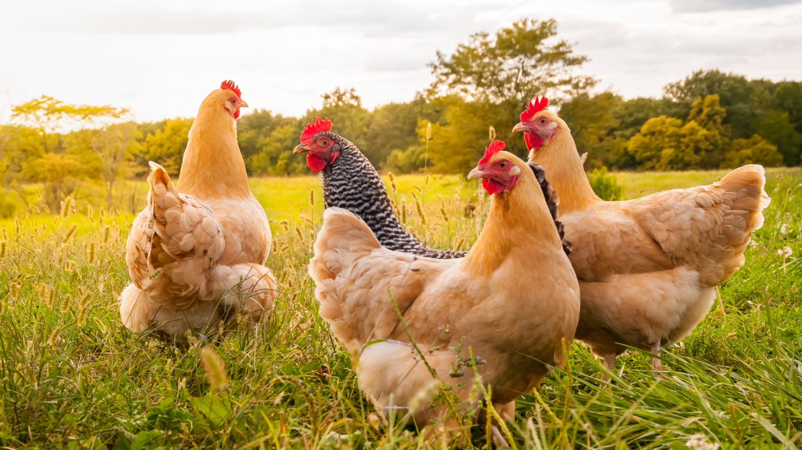
How can following GAP protocol benefit your farm or further your mission?

Slide 20
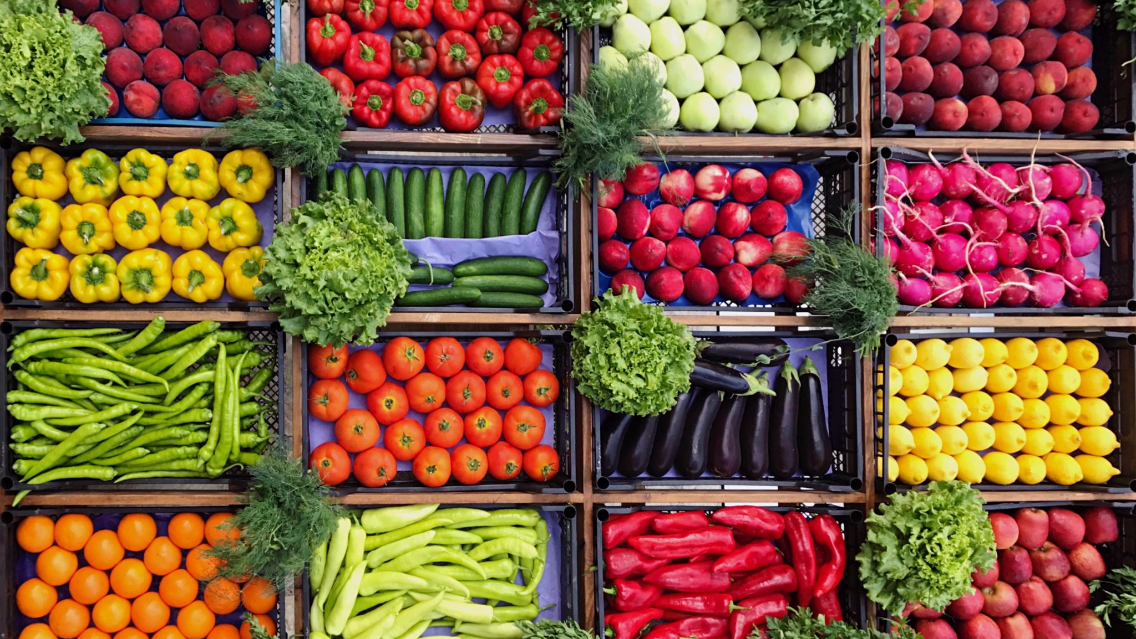
Why GAPs? Farm Benefits!
Quality and shelf-life of your product is maintained, and spoilage reduced
GAPs focus on post-harvest handling and proper cooling, handling and storing of product. This can reduce spoilage, improve quality and ensure that you have the best quality produce for your customers.

Slide 21
Why GAPs? Farm Benefits!
Greater organization and efficiency of your operation
After the initial work of developing a food safety plan, many growers report improved efficiency and streamlined inventory control and management of their products.

Slide 22
Why GAPs? Farm Benefits!
Your customer may require an audit
Many produce distributors and supermarkets require or will soon require all their vendors have a GAP audit. If you wish to sell to this buyer, you must have followed their requirements for certification.

Slide 23
Food Safety Begins on the Farm
Every grower (small, medium, or large) has a responsibility to minimize food safety risks on the farm.
All growers should evaluate their farm practices and begin to implement and train workers on Good Agricultural Practice
Reducing the risk of contamination before it occurs is the best way to minimize the risk of illness in the public.
All growers, regardless of their products, can benefit from implementing a set of SOP to reduce microbial contamination.
GAPs are intended to guide growers to reduce the risk of contamination where possible

Slide 24
Produce most often associated with foodborne illness outbreaks
Lettuces
Salad mix
Green onions
Tomatoes
Sprouts
Cantaloupes
Carrots
Raspberries
Herbs

Slide 25
GAPs Audit Overview
General farm review (includes worker health and hygiene, traceability, water quality, manure and compost, animals and livestock)
Field harvesting and field packing activities
Packing house facility
Storage and transportation
Traceability (this section has been incorporated into other sections)
Wholesale distribution center (applies to distribution centers)
Preventative food defense procedures (applies to distribution centers or very large farms)

Slide 26
GAP Audit Overview
Each section is a checklist related to food safety practices. Everyone must pass the General Farm Review (section 1), but the other sections will vary by grower. Many growers are audited only on 3 or 4 of the sections (e.g. 1, 2, 3 and 4; 1, 2 and 4). Customers who require growers to get an audit will specify which sections are needed.
The rate for GAP/GHP audits is $108.00/hr.

Slide 27
GAPS Audit Checklist

Slide 28
Steps for GAP Certification Success
Develop a Food Safety Plan
Assign a Food Safety Coordinator
Implement Food Safety Plan and SOPs
Run a ‘mock’ recall
Preform an internal audit
Schedule GAP audit

Slide 29
Development of a Food Safety Program
A food safety plan is a written document that covers all aspects of the growing and handling processes, and evaluates the potential sources of risk.
The plan indicates what steps and procedures the operation will take to reduce the risks of contamination by chemical, physical, or microbial hazards.
The produce food safety program should be written by the operation and shall define specific, measurable steps taken by the operation to reduce the risk of microbial, physical and chemical hazards from contaminating the product.
The development of a food safety program is recommended for any operation which produces or handles fresh fruits and vegetables, not just for operations who wish to participate in the USDA GAP&GHP audit verification program.

Slide 30
Development of a Food Safety Program
The food safety plan needs to incorporate the USDA GAP&GHP audit verification program requirements and applicable policies. The following points are key items to consider:
The operation must create a food safety program that accurately reflects their operation.
The operation shall develop Standard Operating Procedures (SOPs) which outline the policies and procedures for the operation.
The operation must designate a person that oversees the food safety program.
The produce food safety program must be implemented and followed.
The operation must determine what to document and keep records for. The operation must also keep all documents and records current.
The operation shall document corrective actions taken which verifies adherence to their food safety plan.

Slide 31
FDA Food Safety Plan Builder
Introduction - YouTube

Slide 32
Sample Food Safety Plan
Sample Harmonized Food Safety Plan (psu.edu)

Slide 33
FSMA Exclusion
Standards for Produce Safety (fda.gov)

Slide 34
How to Request a GAP Audit
If you are a new applicant, you must first establish a billing account with USDA/AMS by completing the SC-430 Vendor Form
Complete the Request for Audit Service Form SC-237A and the Agreement for Participation in Audit Services Form SC-651
Phone: 717-787-4315 Fax: 717-787-1873 RA-AgFruitAndVegReq@pa.gov

Slide 35
Next Steps for GAP certification
Microsoft Word - GAPGHP Users Guide FINAL 4-25-2011 (usda.gov)
Produce Safety Alliance flyer (cornell.edu)
GAP Certification Programs – NASDA
Good Agricultural Practices (GAP) Audits | Agricultural Marketing Service (usda.gov)

Slide 36
Funding for Farms
Accepting SNAP Benefits
1. Get a USDA Account
Before you start your application: Register for a USDA eAuthentication account
2. Complete the SNAP Application
Complete the SNAP application
Tip: After starting this application, you have 30 days to complete and submit it. If you application is not submitted within 30 days, it will be deleted. Before starting this application, make sure that you have name(s), home address(es), and Social Security Number(s) for each store owner, and sales data for the store.
3. Submit Supporting Documentation
Your application is not complete until you submit the required supporting documents. Instructions for submitting your documentation are provided at the end of the application.
4. Check Application Status
After you submit your supporting documents to FNS, you can check the status of your application in real time.
SNAP Retailer Service Center FNS will process your application and contact you if they need any further information. If you have additional questions, please call the SNAP Retailer Service Center at 1-877-823-4369.

Slide 37
Funding for Farms
Accepting Farmer Market Nutrition Vouchers for WIC recipients and Seniors
The WIC Farmers Market Nutrition Program (FMNP) and Senior Farmers Market Nutrition Program (SFMNP) is looking for eligible farmers to join the program.
To be eligible:
· Must grow fresh fruits, vegetables, fresh cut herbs in Pennsylvania.
· Grow produce with a retail value of at least $1,000.
· No citrus fruits, honey, or processed foods.
Please contact Tierney Belanger at (717) 783-5309 or tiebelange@pa.gov to learn more and to apply.

Slide 38
Funding for Farms
Processing Credit Card Sales
Credit Cards
Company | Transaction Rates | Processor | Online Sales | Contact
Pro Merchant | 0.35% + $0.10 | Included | Available | ProMerchant - Credit Card Processing
Clover | Must contact | Must contact | Must contact | Clover | Credit Card Processing
Merchant One | 0.29% - 1.55% | Must contact | 0.29%-1.89% | Credit Card Processing
Square | 0.35% + $0.15 | Included | Rates vary | Square | Solutions
Paypal | 2.29% + $0.09 | $29 - $79 | Rates vary | Card Reader

